Slide 1
Systems Thinking
Game Patterns
CT Basic Concepts
Computational Patterns

Slide 2
Game
Mechanics
Game
Polish
Challenge Systems
Game
Space
Notes:
#FD9A28
#26A7FF
#162C9B

Slide 3
Coding Concepts
Design Practices
21st Century Skills
Computing Patterns and Systems Concepts
Notes:
#FD9A28
#26A7FF
#162C9B

Slide 4
Coding Concepts
Design Practices
Game
Patterns
Systems Concepts
Notes:
#FD9A28
#26A7FF
#162C9B

Slide 5
Systems
Thinking
Coding Concepts
Game Patterns
Computing
Patterns

Slide 6
Systems
Thinking
Coding Concepts
Game Patterns
Computing
Patterns

Slide 7
Systems
Thinking
Coding Concepts
Game Patterns
Computing
Patterns

Slide 8
Design
Practices
Systems
Thinking
Game Patterns
Coding Concepts
21st Century
Skills
Computing
Patterns

Slide 9
Systems
Thinking
Coding Concepts
Game Patterns
Computing
Patterns
More Concrete
More Abstract

Slide 10
Systems Thinking
Game Patterns
CT Basic Concepts
Computational Patterns

Slide 11
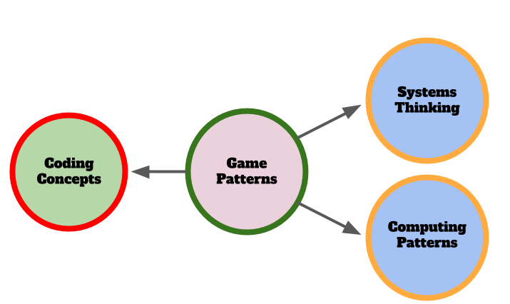

Slide 13
Design
Practices
Systems
Thinking
Game Patterns
Coding Concepts
21st Century
Skills
Computing
Patterns
Game Patterns

Slide 14
Game Patterns

Slide 15
Design
Practices
Game Patterns
Coding Concepts
21st Century
Skills

Slide 16
Design
Practices
Systems
Thinking
Game Patterns
Coding Concepts
21st Century
Skills
Computing
Patterns

Slide 17
Design
Practices
Systems
Thinking
Game Patterns
Coding Concepts
21st Century
Skills
Computing
Patterns
Game Patterns

Slide 18
More Concrete
Design
Practices
Systems
Thinking
Game Patterns
Coding Concepts
21st Century
Skills
Computing
Patterns
More Abstract
Game Patterns

Slide 19
Updated Version
Less concrete / abstract distinction

Slide 20
More Concrete
Game Patterns
Coding Concepts
Design
Practices
Systems / Computational
Thinking
More Abstract
Game Patterns

Slide 21
Game Patterns
Coding Concepts
Design
Practices
Systems Patterns
Sequences
Variables
Logic
Loops
Arrays
Creating Functions
Change Listener
Input Event
Goal Setting
Being Incremental and Iterative
Developing Vocabulary
Reusing and Remixing
Web Navigation
Problem Solving
Version Control
Debugging
Reusing and Remixing
Game Testing and Publishing
Systems Elements
Systems Dynamics
Reinforcing Feedback Loops
Balancing Feedback Loops

